Slide 1
Ch4.6R
Review Problems on Rational Functions:

Slide 2
1st step: Make a chart
 | Distance | Speed | Time
Ero
Jamal
How much more time did Jamal needed more Ero?
So Jamal’s time subtract Ero’s time will be 2 1/3 hours
Now solve this equation

Slide 3
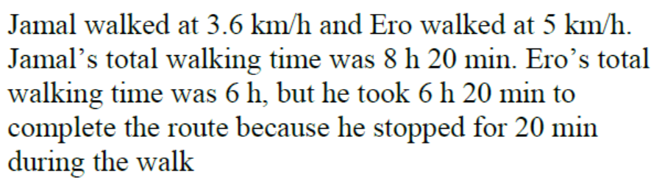
Find the LCD: 3(x)(x+1.4)
Multiply all terms by the LCD to get rid of the denominator
Use the QF or Factor
Can’t have a negative speed

Slide 4
1st step: Make a chart
 | Distance | Speed | Time
Arshia
Sarah
Arshia’s break was 30 minutes, so she had 30 minutes less time to travel
She also arrived 15 minutes later, so needing 15 minutes more to finish
Overall, she had 15minutes less than Sarah, that’s ¼ hours

Slide 5
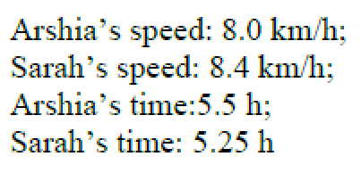

Slide 6
1st step: Make a chart
 | Distance | Speed | Time
Up Stream
Down Stream
Total time was 16 hours
Now solve equation!!

Slide 7
The speed of the current is 5km/hr

Slide 8
1st step: Make a chart
 | Distance | Speed | Time
Up Stream
Down Stream
Total time was 6 hours
Now solve equation!!

Slide 9
John was rowing at 6km/hr

Slide 10
1st step: Make a chart
Profit = Revenue - Expense
 | # of Shirts | Cost per Shirt | Total Amount
Expense and Cost
Revenue Sales

Slide 11
Jaime sold 18 shirts

Slide 12
1st step: Make a chart
 | Number of Days | Cost per Day | Total Amount
Original Plan
Actual Plan

Slide 13
Stuart expected to finish the job in 12 days. However, he ended spending 16 days to finish the job

